Slide 1


SAP ABAP Solutions for Sales and Distribution Sector
SURE Trust - SKILL UPGRADATION FOR RURAL YOUTH EMPOWERMENT
COURSE: SAP ABAP
DURATION: NOV 2025 – APRIL 2026 (6 Months)
Submitted By:
PRAGADA HARATHI
Under the Guidance of:
Mr. Santoshkumar Ramlakhan Pal
SAP ABAP Associate Consultant
Infosys Limited
Department of ECE

Slide 2
Contents
Introduction
Problem Statement
Objectives
Tools & Technologies
Project Modules
Methodology
SmartForm Implementation
ALV Report with Excel Download
SUBMIT (ME2M Report)
Results
Industry Relevance
Learning Outcomes
Conclusion
Future Scope
SAP ABAP

Slide 3
Introduction
The sales and distribution sector produces high volume of data related to customers, sales orders, deliveries and billing operations.
Accurate and well-organized data management is crucial for reliable decision-making and operational efficiency.
Data management and processing are effectively handled using ERP systems like SAP.
SAP ABAP helps in building custom reports and streamlining operations through automation..
This project aims to enhance sales and distribution reporting using SAP tools.
SAP ABAP

Slide 4
Problem Statement
Manual handling of sales and customer information results in inaccuracies.
Absence of a structured and automated reporting framework in sales operations.
Challenges in interpreting large volumes of sales, order, and billing data.
Lack of an effective mechanism to extract and share data for external use.
Lengthy and inefficient process for generating sales and distribution reports.
SAP ABAP

Slide 5
Objectives
To design a Smart Form for structured and professional sales data presentation.
To develop an interactive ALV report for analyzing sales and distribution data.
To enable Excel export functionality for easy data sharing and external analysis.
To automate report execution using SUBMIT (ME2M) for seamless integration with
standard SAP reports.
To enhance operational efficiency and data handling in sales and distribution processes.
SAP ABAP

Slide 6
Tools & Technologies
SAP ABAP – Programming for development
Smart Forms – Formatted document creation
ALV (ABAP List Viewer) – Interactive reporting
SAP GUI – System interface
SE38 – ABAP coding editor
SE11 – Table and data management
SE80 – Object development tool
SAP ABAP

Slide 7
Project Modules
SmartForm Development:
Built using BUT000 and KNA1 tables. Presents data in a structured format.
2. ALV Report with Excel Export: Interactive report with sorting and filtering features.
Supports data download functionality.
3. ME2M Report via SUBMIT: Executes standard SAP report using SUBMIT.
SAP ABAP

Slide 8
Methodology
Data Extraction:
Data is retrieved from SAP tables using efficient selection logic.
Data Processing:
Data is processed using ABAP logic to generate meaningful insights.
Report Generation:
Smart Forms produce formatted output, while ALV provides interactive display.
Automation:
SUBMIT used to execute standard ME2M report.
Automation:
Smart Forms produce formatted output, while ALV provides interactive display.
Output:
Results are displayed on screen and can be exported to Excel
SAP ABAP

Slide 9
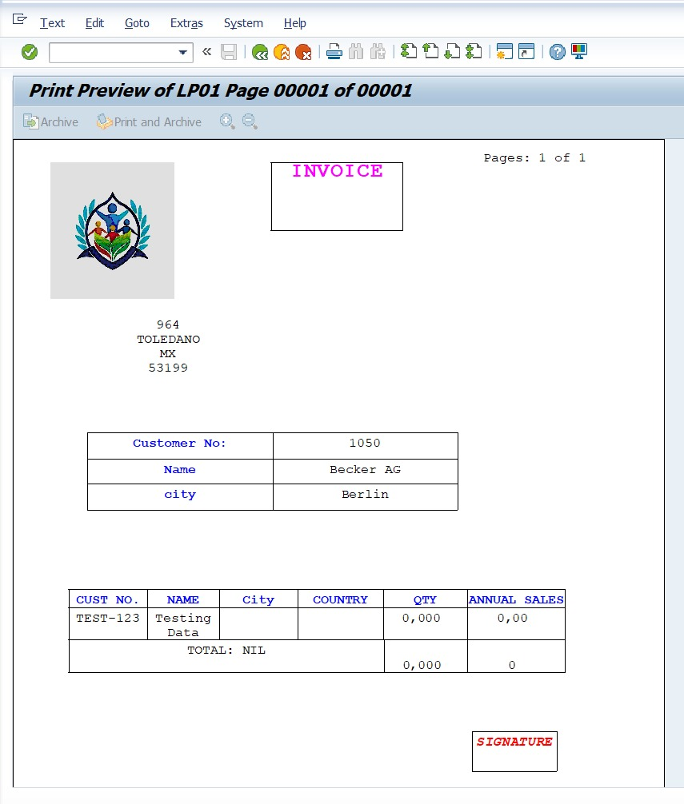
SmartForm Implementation
Smart Form developed using the SAP SmartForms
tool.
Data is retrieved from BUT000 and KNA1 tables.
Structured layout includes: Header Main Window Footer
Displays: Customer and related data in a well-formatted,
structured output.
Fig: Smartform Output
SAP ABAP

Slide 10
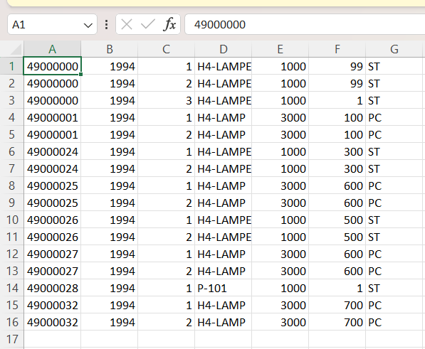
ALV Report with Excel Download
Developed using ALV (ABAP List Viewer)
Presents data in an interactive tabular format
Features include: Sorting Filtering
Includes Excel download functionality
Fig: ALV Excel Output
SAP ABAP

Slide 11
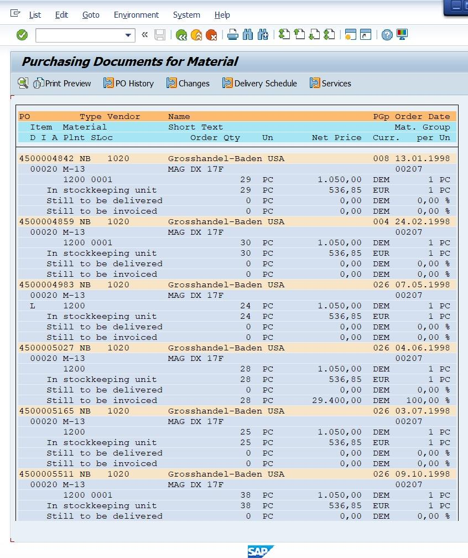
SUBMIT (ME2M Report)
Utilized the SUBMIT statement in SAP
ABAP
Invokes the standard SAP program
(ME2M report)
Passes required parameters: Material Plant
Generates output consistent with the standard
ME2M report
Fig: ME2M Output
SAP ABAP

Slide 12
Results
Successfully generated Smart Form output
Developed an interactive ALV report
Implemented Excel download functionality
Automated ME2M report execution using SUBMIT
Minimized manual effort and enhanced efficiency
Ensured accurate and well-structured data reporting
SAP ABAP

Slide 13
Industry Relevance
Applicable in sales and distribution organizations.
Enables efficient management of customer, order, and billing data.
Reduces manual effort and minimizes errors in sales operations.
Supports ERP-driven digital transformation in sales processes.
Enhances decision-making with accurate and real-time sales insights.
SAP ABAP

Slide 14
Learning Outcomes
Acquired proficiency in SAP ABAP development
Designed Smart Forms for structured document output
Built interactive ALV reports with enhanced usability features
Enabled Excel export capability for data sharing
Gained hands-on experience with the SUBMIT statement
Strengthened debugging and analytical problem-solving skills
Developed understanding of real-time SAP project implementation
SAP ABAP

Slide 15
Conclusion
Successfully developed a sales and distribution reporting system using
SAP ABAP.
Integrated Smart Forms, ALV, and SUBMIT functionalities for end-to-end
reporting.
Enhanced data accuracy and reporting efficiency in sales operations.
Reduced manual intervention through automation of reporting processes.
Demonstrated practical application of SAP ERP in the sales and distribution
domain.
SAP ABAP

Slide 16
Future Scope
Integration with SAP Fiori apps for a modern and user-friendly sales interface.
Development of real-time sales dashboards for monitoring orders, revenue, and performance.
Integration with e-commerce platforms and external sales systems.
Implementation of advanced analytics for sales forecasting and demand planning.
Automation of order processing and billing workflows for faster operations.
Integration with mobile applications for on-the-go sales tracking and approvals.
Use of AI-based recommendations for pricing, customer behavior, and sales trends.
Enhancement of customer relationship management (CRM) integration for better
customer insights.
SAP ABAP

Slide 17
Thank You
SAP ABAP

